Slide 1
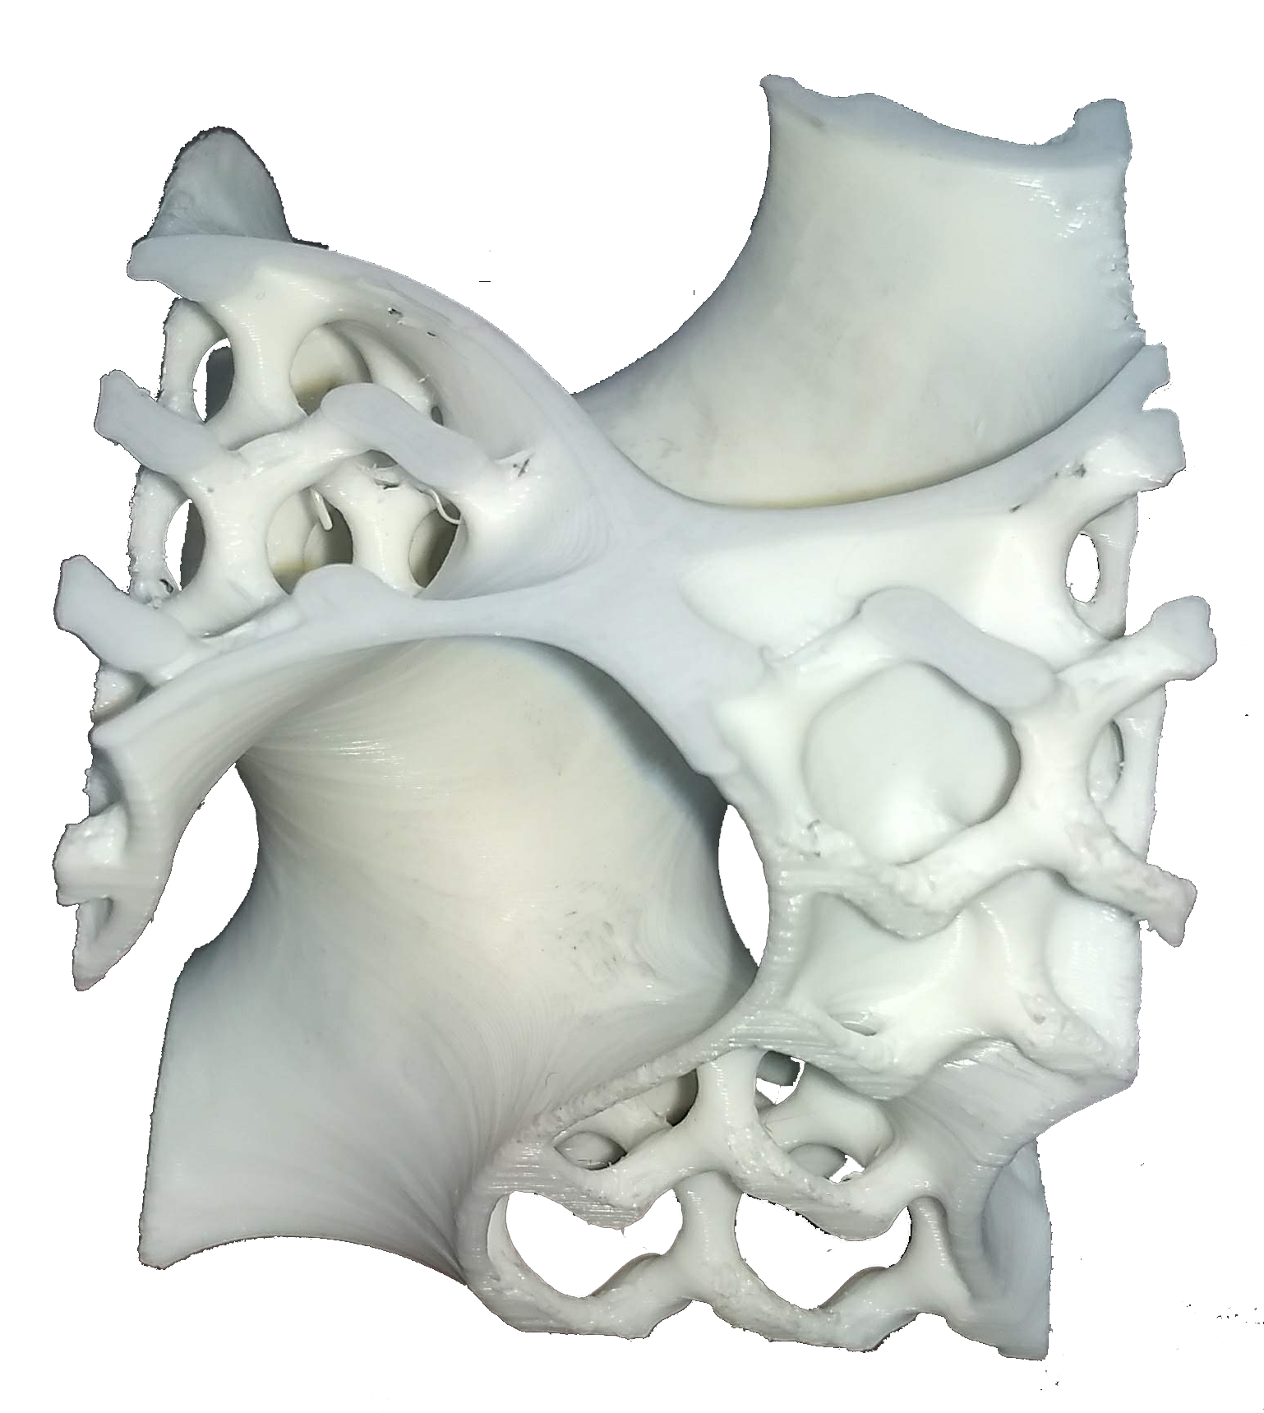
Memory Efficient Voxel Processing Library
Radhikabahen D Patel
Senthil Palanivelu
Jithin Jacob
Quan Tran
Department of Computer Science
Notes:
Our project is about Memory Efficient Voxel Processing Library. And Our team members includes: Radhikabahen, Casear, Jithin, and myself (Quan).

Slide 2
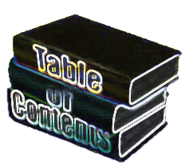
Table of Contents
Client Background
Problem Statement
Literature Survey
Algorithm
API Design and Coding
Live demo
Test and Analysis
Challenges and Lesson Learned
Notes:
This is a Overview of our presentation.
Who is our client, what is their problem and why they need our help?
How implement this solution?
We will have a live demo of our production. And what is the results?
And Finally, what challenges our team encountered and what lesson did we learned?

Slide 3
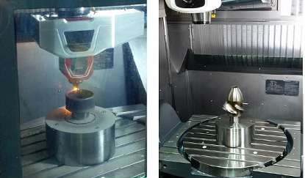

Client Background
3-D Rapid Prototyping and 3-D Rapid Manufacturing.
Return to Table of Contents
Notes:
They are Leading in 3-D Rapid Manufacturing solution provider
Focus on software and consulting services in 3-D Rapid Prototyping and 3-D Rapid Manufacturing.

Slide 4
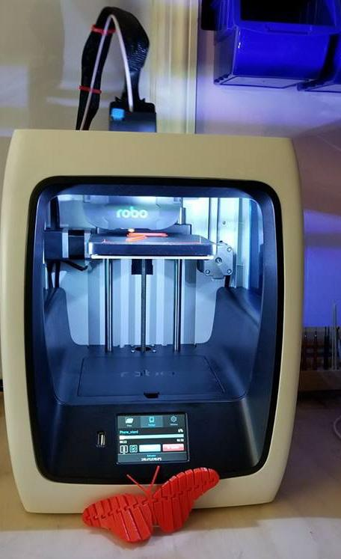
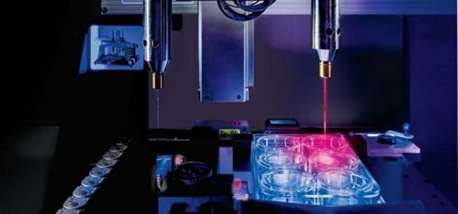
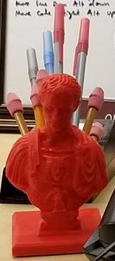
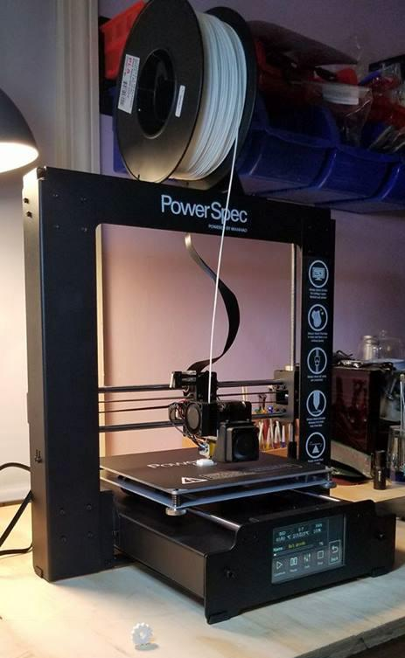
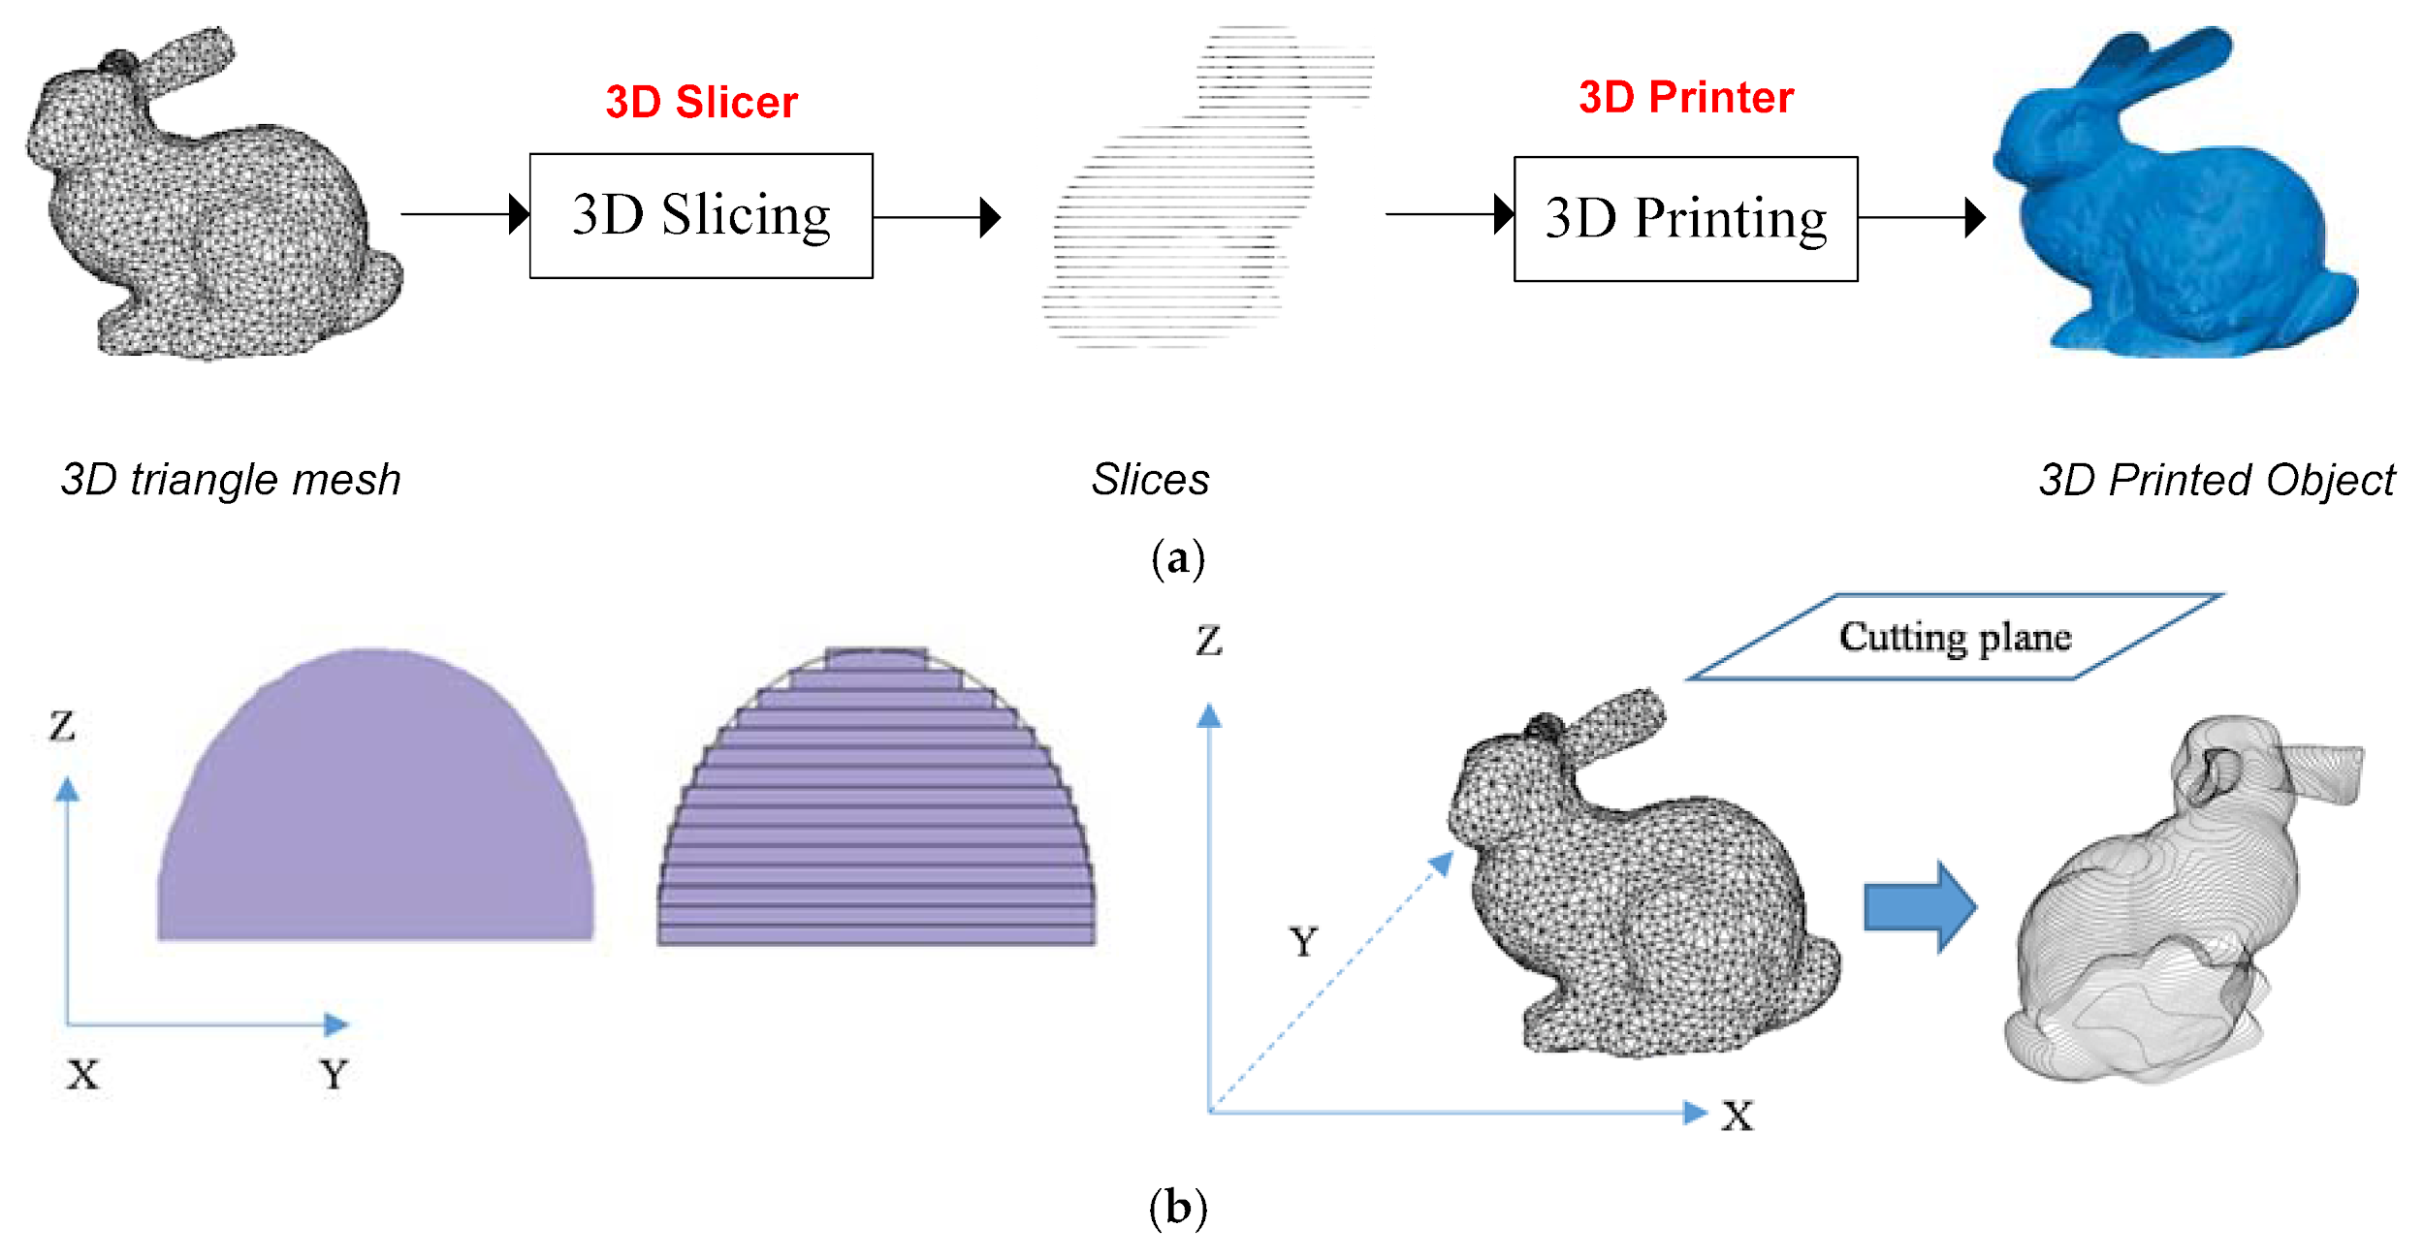
Client Services
So Something Like 3D Printing Hobbies???
http://www.3ders.org/articles/20151230-3d-printing-year-in-review-the-biggest-3d-printing-news-stories-of-2015.html
https://www.mdpi.com/2079-9292/7/2/23
Return to Table of Contents
Notes:
In other word, Think of it something like 3D Printing but instead of ABS or PLA, it is in Metal???

Slide 5
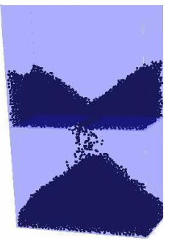
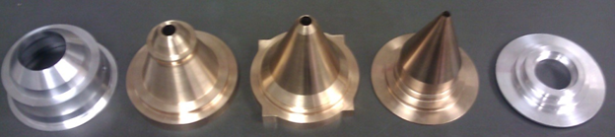
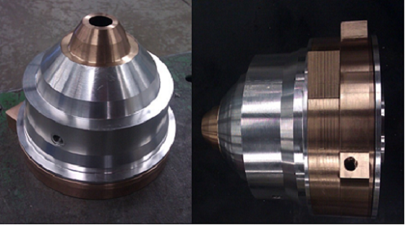
Client Services
Custom-designed Powder Feeders, Nozzles, etc.
Design and Integrate System for Hybrid Machines
Such as integrating CNC Machines, Laser, Sensors, with PINE's Multi-Axis Planning Software for Additive Manufacturing Machines
PINE's CNC Machined Co-Axial Nozzle For Metal Deposition
Return to Table of Contents
Notes:
This is One of their many services: Custom Designed Powder Feeders, Nozzles, etc.
One of the tool they used to make this final product for custom designing process is Morphological Operation.

Slide 6
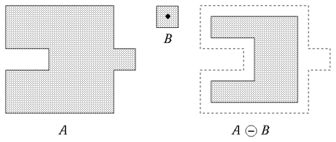
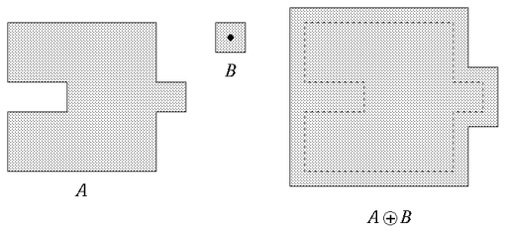
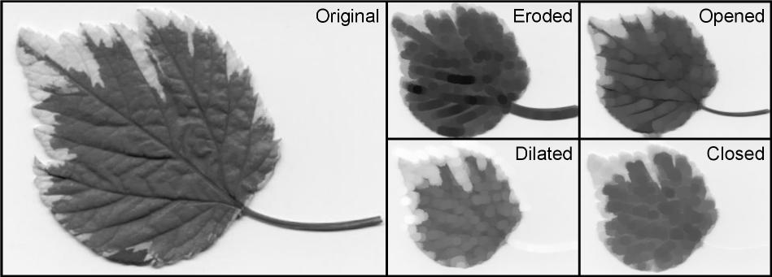
What is a Morphological Operation?
Dilation
Erosion
http://www.inf.u-szeged.hu/ssip/1996/morpho/morphology.html
http://rsb.info.nih.gov/ij/plugins/images/gray-morphology.jpg
Return to Table of Contents
Notes:
So what is Morphological Operation?
Here are two set operator example. Erosion and Dilation.
It take a binary image and a structuring element as input and combine them using a set operator.

Slide 7
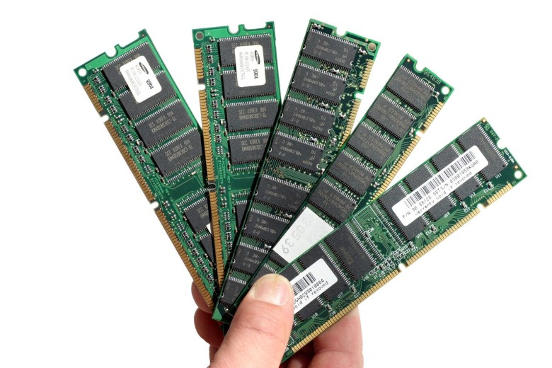

So what is the problem?
Why do they need our help?
Out Of Memory?
File is too large to load into memory
Computational bottleneck in large computed imaging problem
Problem
https://www.cultofmac.com/297873/apple-will-dominate-25-worlds-ram-2015/
Return to Table of Contents
Notes:
So what is the problem?
Why they need our help?
In Short, With a given file size,
it is too large to load into memory.
And causes bottleneck in large computed imaging problem.

Slide 8

Requirements
Compressed Data Structure for Large Matrices
Castable to NumPy array
Lower Memory Consumption
Support Morphological Operations
Support Arithmetic Operations
Return to Table of Contents
Notes:
This lead to what is our requirement?
Compressed Data Structure for Large Size Matrice
Castable to Numpy array
Lower Memory Consumption
Support Morphological Operation
And Last but not least, Support Arithmetic Operation
Our Approach:
Our approach allows to operate large Sparse matrices that would not fit into RAM memory as a whole . The idea is to store the Sparse Matrix in a compressed data structure and retrieve blocks of data from the compressed data structure and dynamically allocating memory and performing the Morphological operations.
Features:
• Compressed 3d array data structure
• Castable to and from a numpy.array instance in Python 3.6
• Addressable similar to a numpy array
• Morpological operations such as erode and dilate
• Math operations (per-element add/subtract/divide)
• Isosurface computation (e.g. marching cubes)

Slide 9
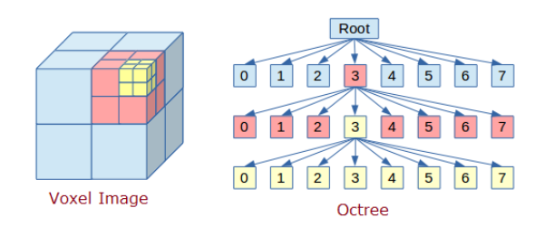
Literature Survey
Octree Data Structure:
Data structure in which each internal node has exactly eight children
Used to partition 3D space by recursively subdividing itself into 8
Used to obtain high speeds during morphological operations
Provides extremely tight compression of sparsely populated spaces
Disadvantage
Memory grows exponentially with respect to the depth of the tree
Return to Table of Contents

Slide 10
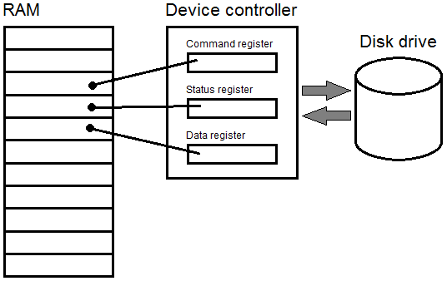
OpenVDB
Open-source C++ library comprising a novel hierarchical data structure
Suite of tools for the efficient storage and manipulation of sparse volumetric data
Disadvantage
Runs on Python 2.7, but client uses Python 3
Memory Mapping Technique
Used for accessing small
segments of large files on
disk, without reading the
entire file into memory
Split the Large 3D array
into “n” smaller 3D blocks
Iterate through each block
and perform morphological
operations

Slide 11
Memory Mapping Technique
Merge all blocks
We use the Python Dask module for implementation
library for parallel computing in Python
has 2 parts
Dynamic task scheduling optimized for computation
“Big Data” collections such as parallel arrays and lists that extend common interfaces like NumPy to distributed environments.
Dask is specifically designed to work on large collections parallely
Compression
We also looked at different compression techniques for sparse arrays such as Compressed Row Storage and Compressed Column Storage.
Return to Table of Contents

Slide 12
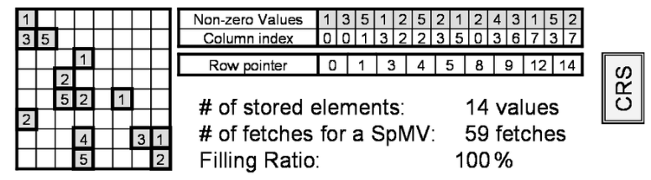
Our Algorithm
The idea is to store the Sparse Matrix in a compressed data structure and retrieve blocks of data from the compressed data structure and allocate memory and perform the morphological operations.
Representing a sparse matrix by a 2D array leads to wastage of lots of memory as zeroes in the matrix are of no use in most of the cases. So, instead of storing zeroes with non-zero elements, we only store non-zero elements. This means storing non-zero elements with triples- (Row Pointer, Column, value).
Return to Table of Contents

Slide 13
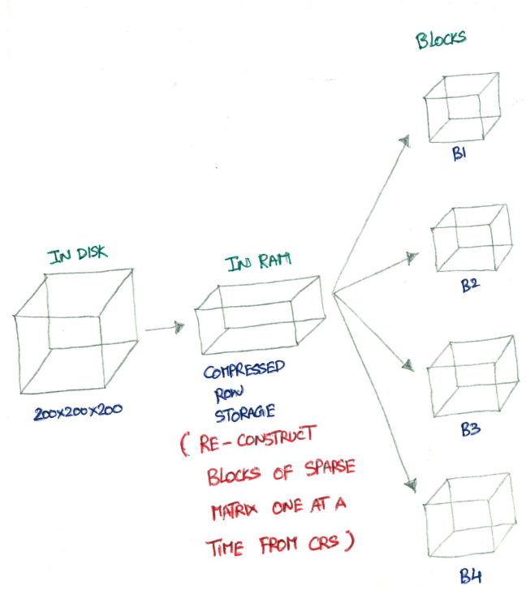
Return to Table of Contents

Slide 14
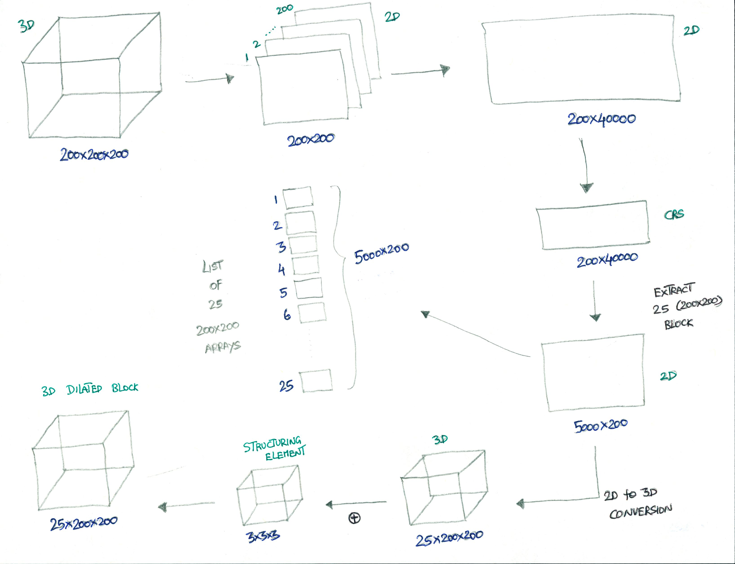
Return to Table of Contents
Return to Table of Contents

Slide 15
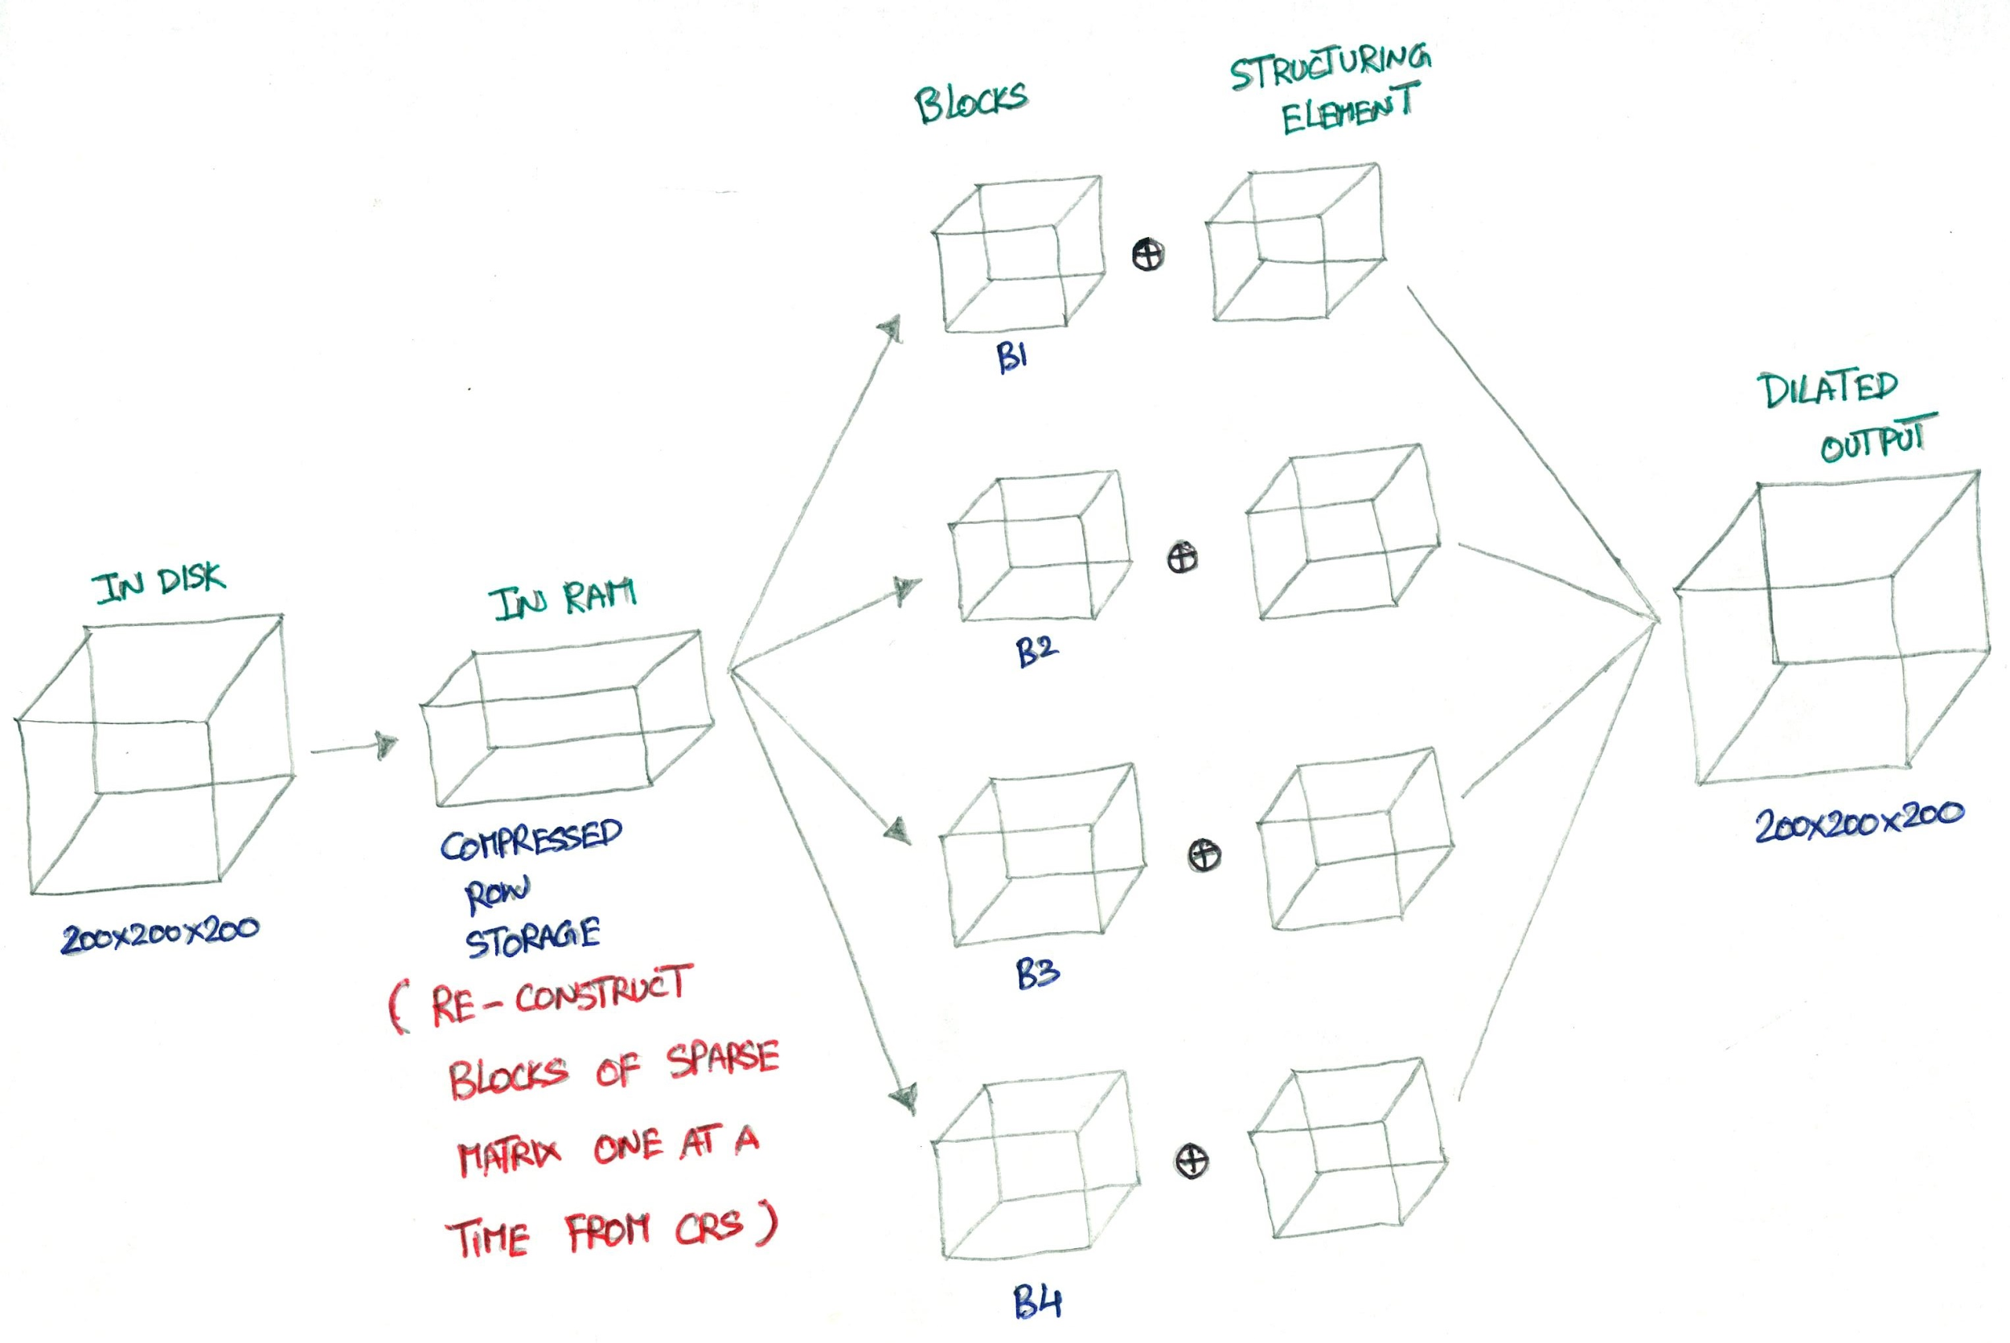
Return to Table of Contents

Slide 16
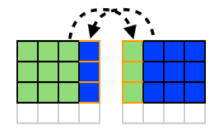
Overlapping Blocks
Problem in calculating the values at the borders between blocks since these require values from one or more neighboring blocks
The solutions is to allocate additional space for a series of ghost cells around the edges of each block. For every iteration, have each pair of neighbors exchange their borders and place the received borders in the ghost cell regions
Each block receives a vector of ghost cells from the neighboring block
Return to Table of Contents

Slide 17

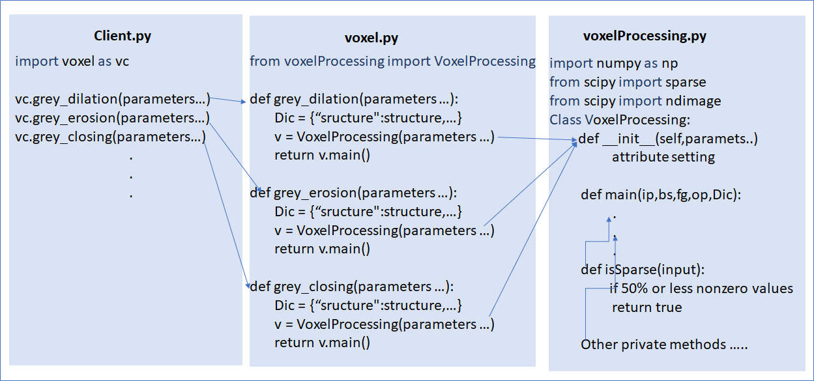
API Design and Coding
Return to Table of Contents

Slide 18
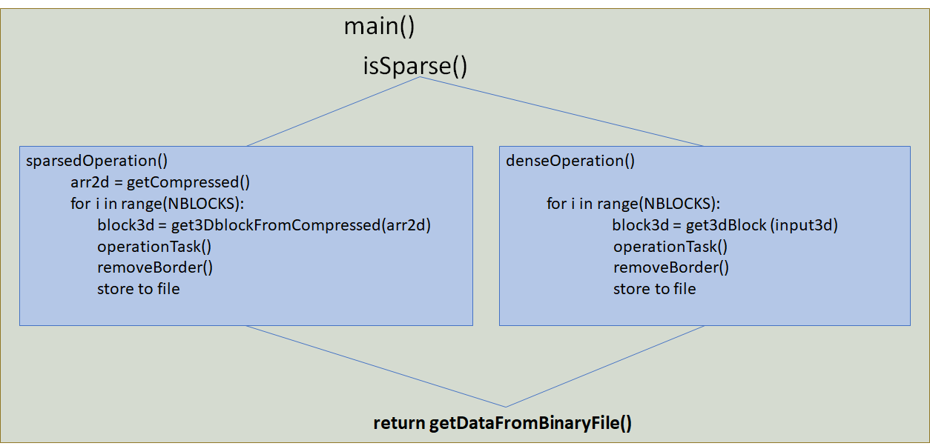
API Design and Coding
Return to Table of Contents

Slide 19
Live Demo
Return to Table of Contents

Slide 20
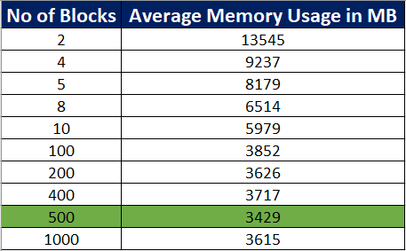
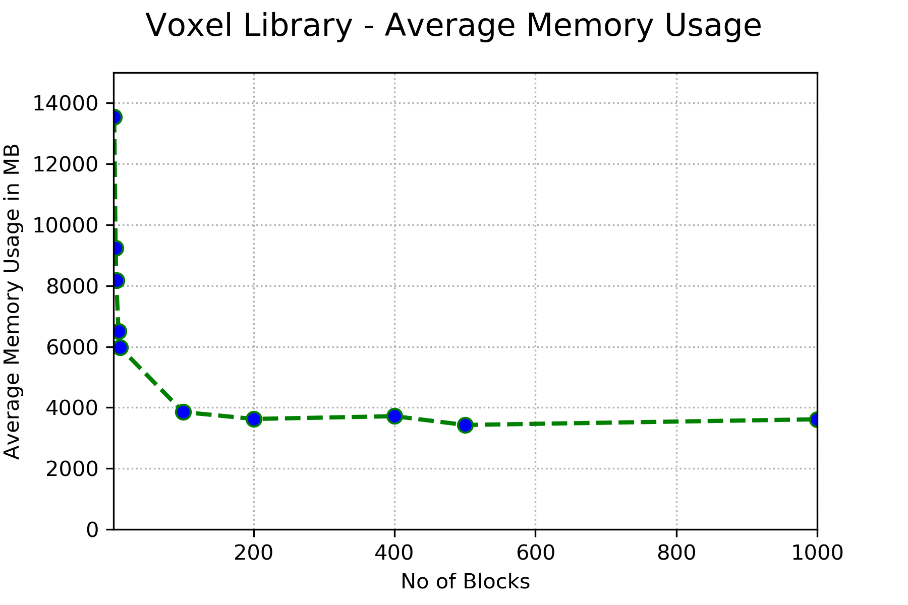
Test and Analysis
Test:
Input Matrix Dimension = 2000 x 1500 x 1500
Matrix Density = 10 %
Matrix size = 17 GB
Compressed Object size = 3.6 GB
When the operation is directly called on python scipy ndimage library the system ran out of memory. OSError: [Errno 12] Cannot allocate memory . The total system memory is 32gb.
When we use our Voxel Processing Library , you can see that the average memory usage drops with respect to the number of blocks.
The minimum average memory usage is 3.4 GB using 500 blocks of operation.
Return to Table of Contents

Slide 21
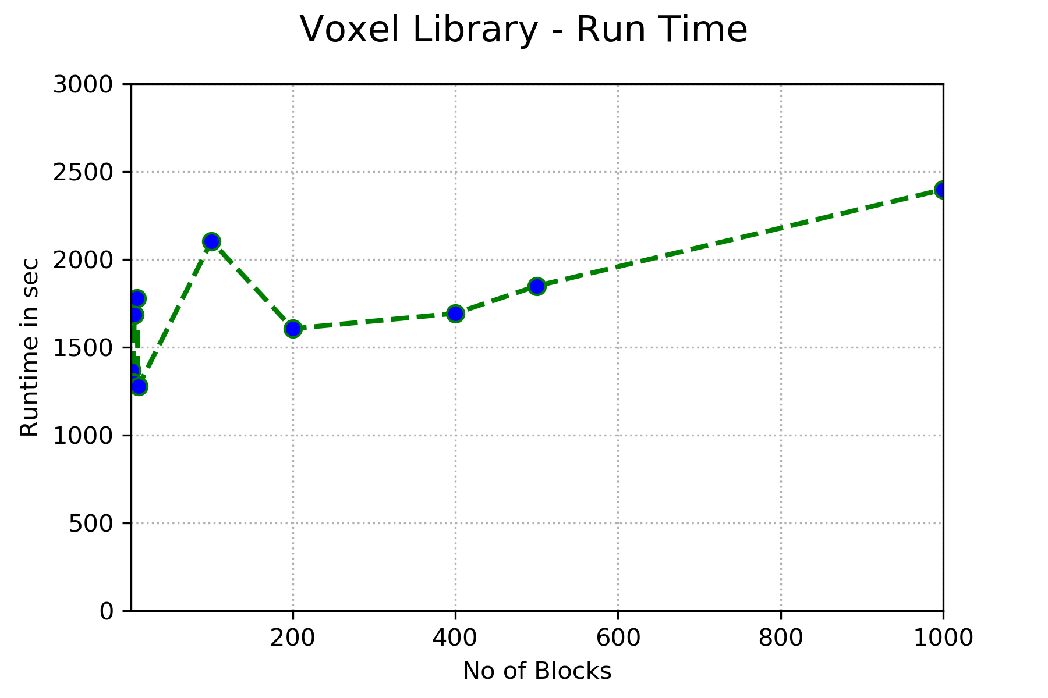
Test and Analysis
For the minimum average memory usage 3.4 GB using 500 blocks of operation the runtime is 30 min.
Return to Table of Contents

Slide 22
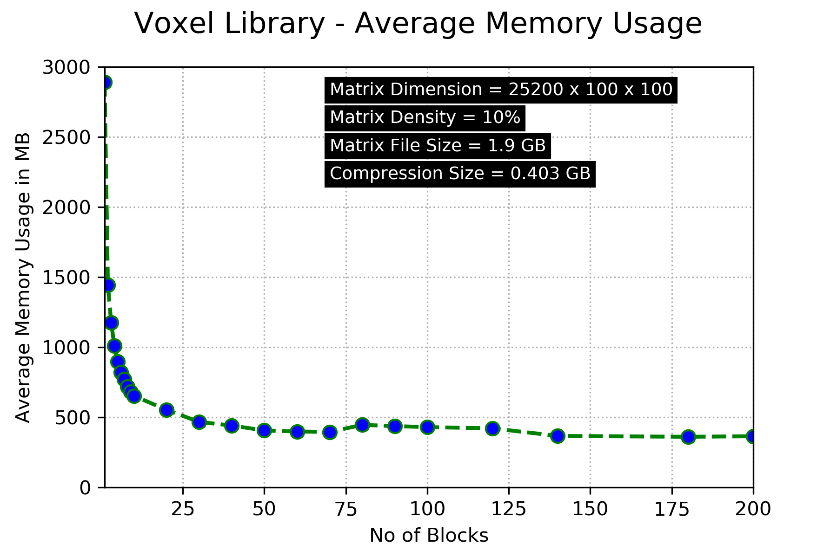
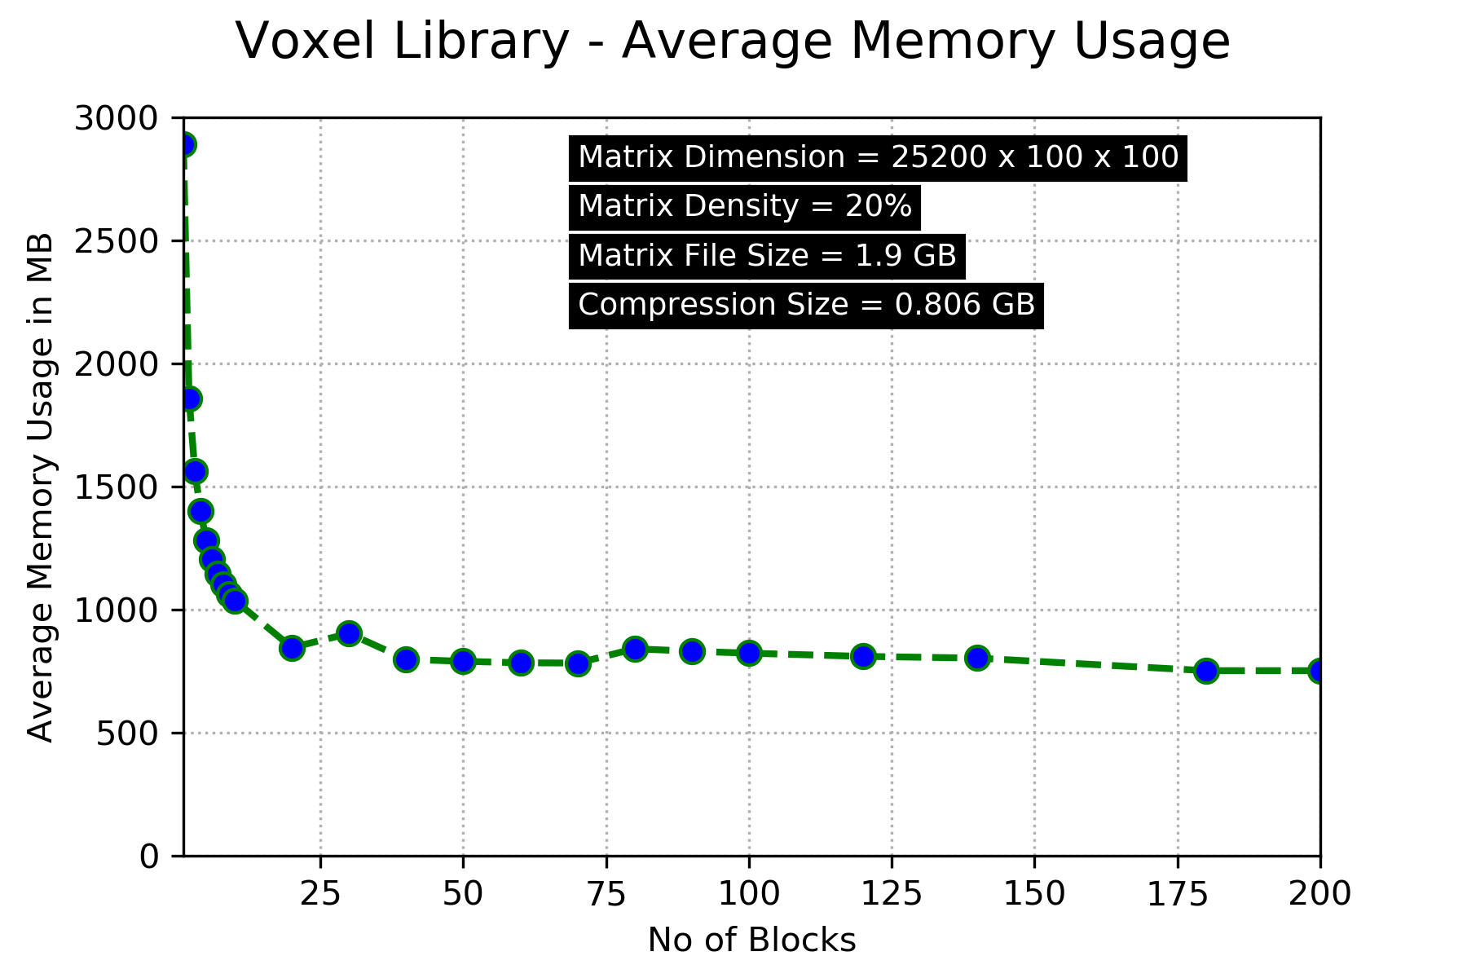
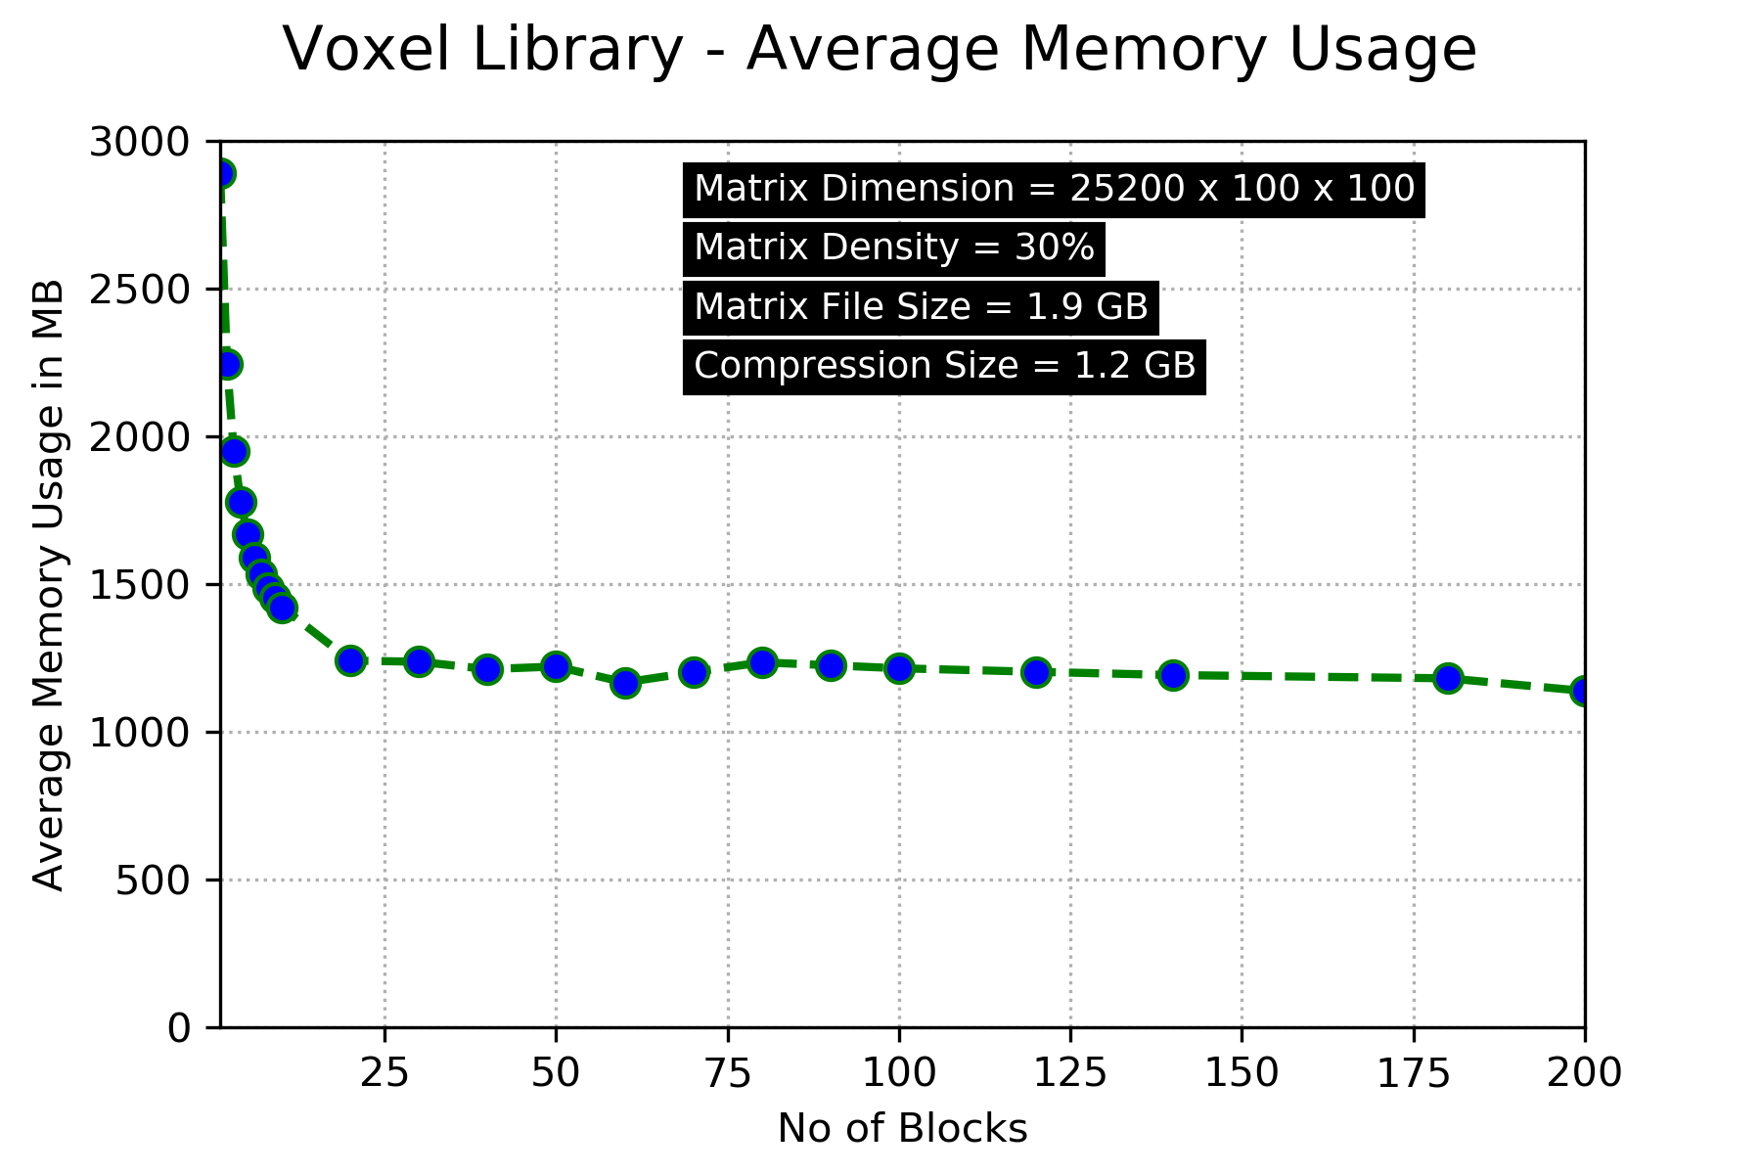
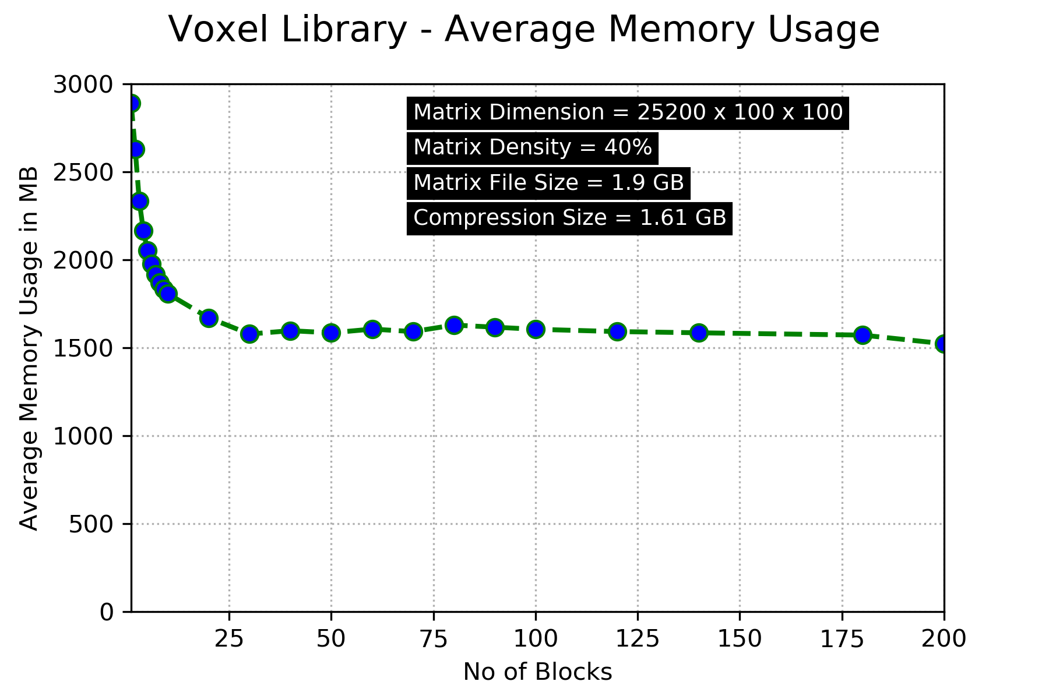
Return to Table of Contents

Slide 23
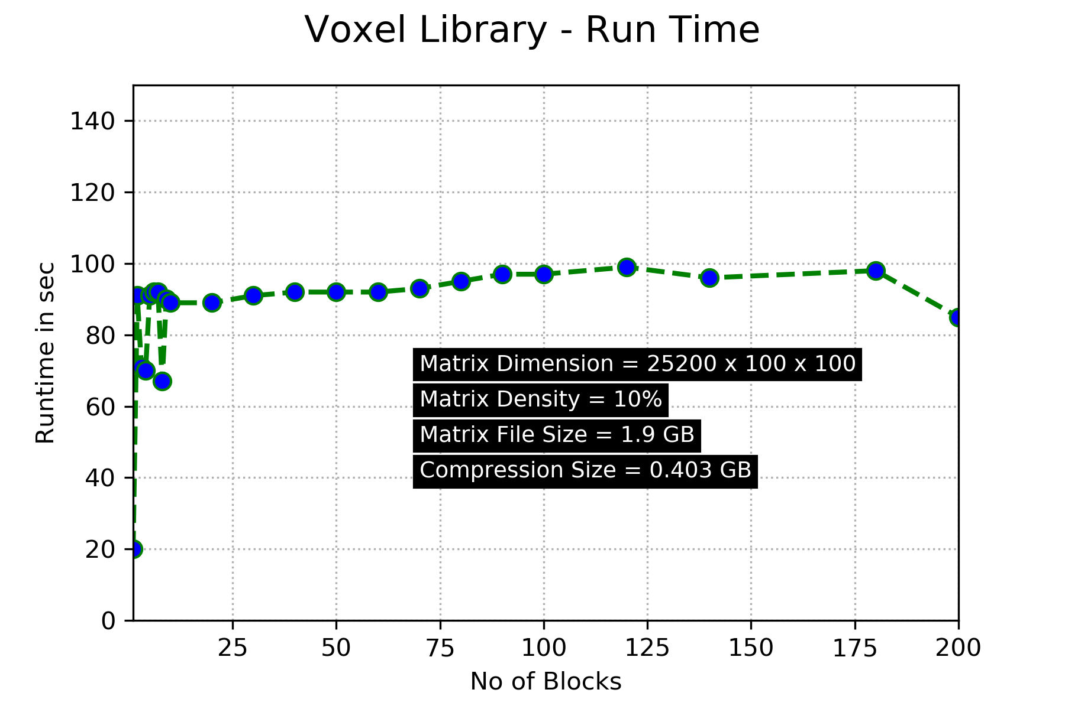
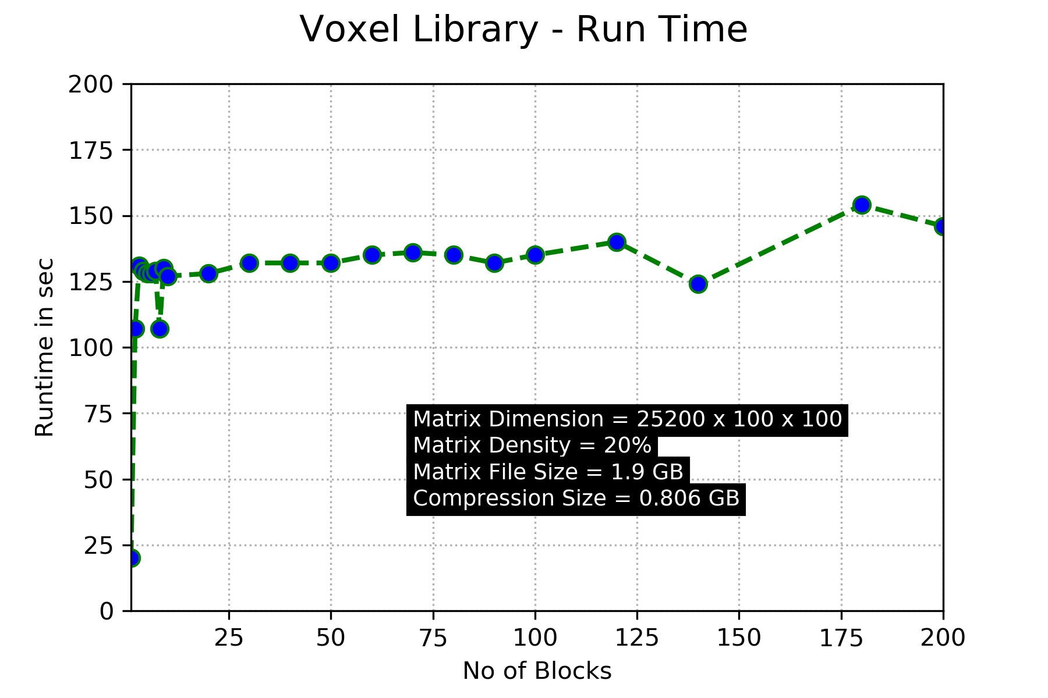
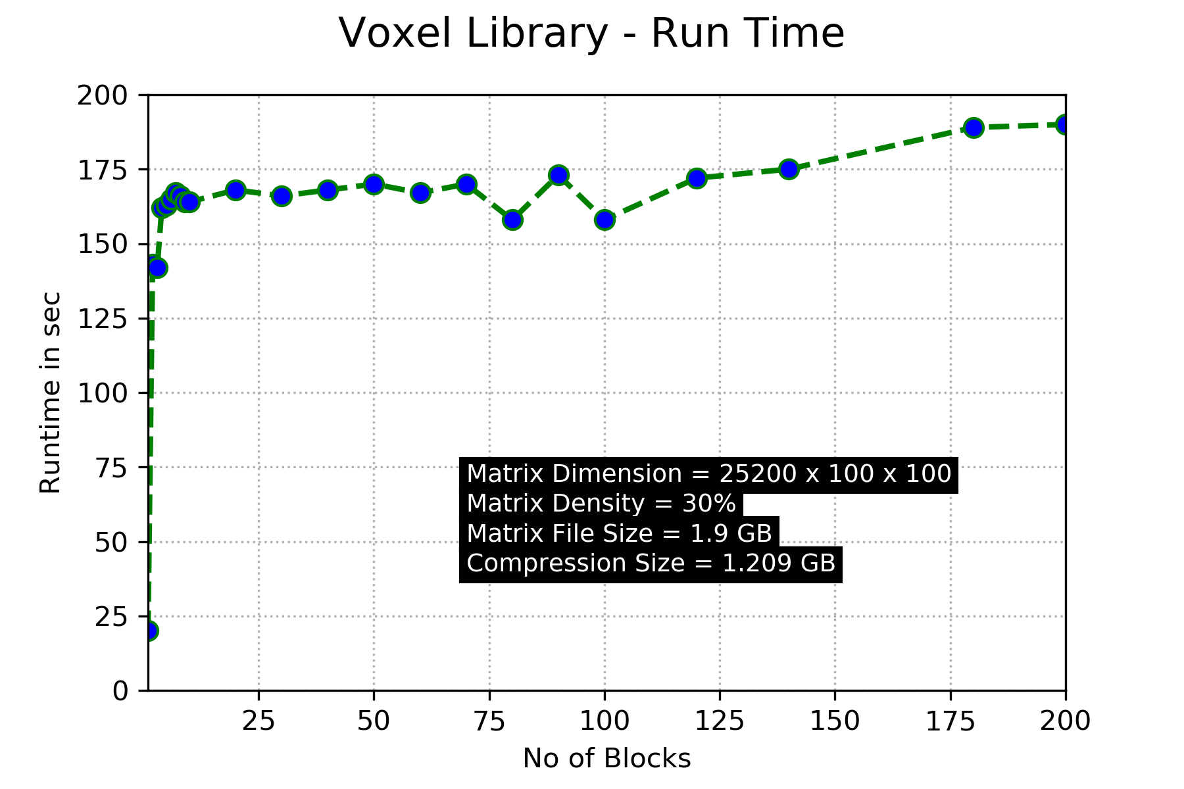
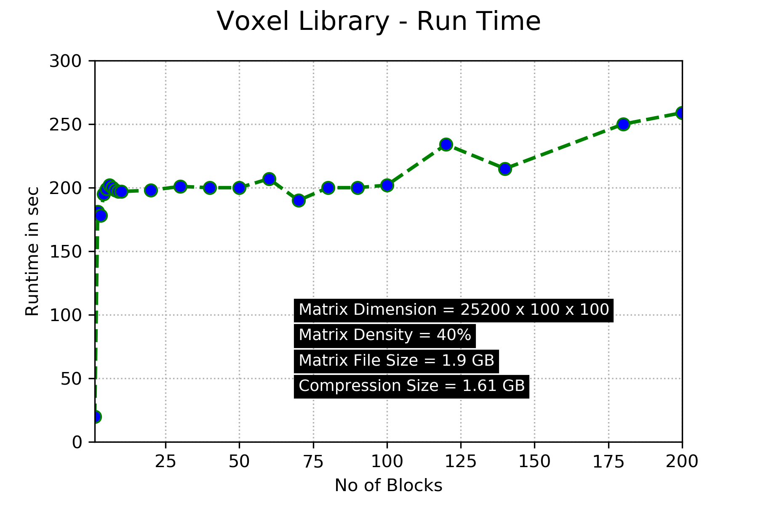
Return to Table of Contents

Slide 24
Test and Analysis
Number of blocks threshold and minimum average memory usage depend on the density of the matrix
For matrix with high density, the library achieves lower memory consumption using fewer blocks of operations
For matrix with low density, the library achieves lower memory consumption using more blocks of operations.
Return to Table of Contents

Slide 25
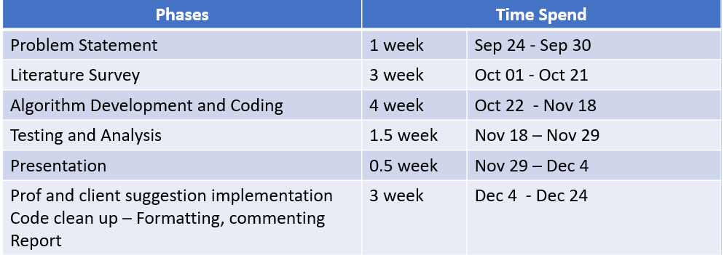
Challenges and Lesson Learned
To work in Team - Team member with different schedule.
Python Modules numpy, scipy, os etc
Morphological Operation with multidimensional array - 3D
How to balance between memory usage and time.
How to design API
Google python style guide
Different compression technique and current research related to this problem.
How to report software development and put things in right words.
Python is simple but not easy
Return to Table of Contents

Slide 26
Special Thanks!
Todd Sparks - Our Client
Kenneth Fletcher
Return to Table of Contents
Notes:
And that is ALL

